Slide 1
Plant and Environment Monitoring. An Azure IoT and Power BI Project
Ben Watt
www.datalineo.com

Slide 2

Agenda
The Process
Analytics in Power BI

Slide 3





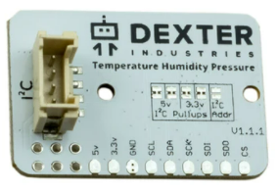

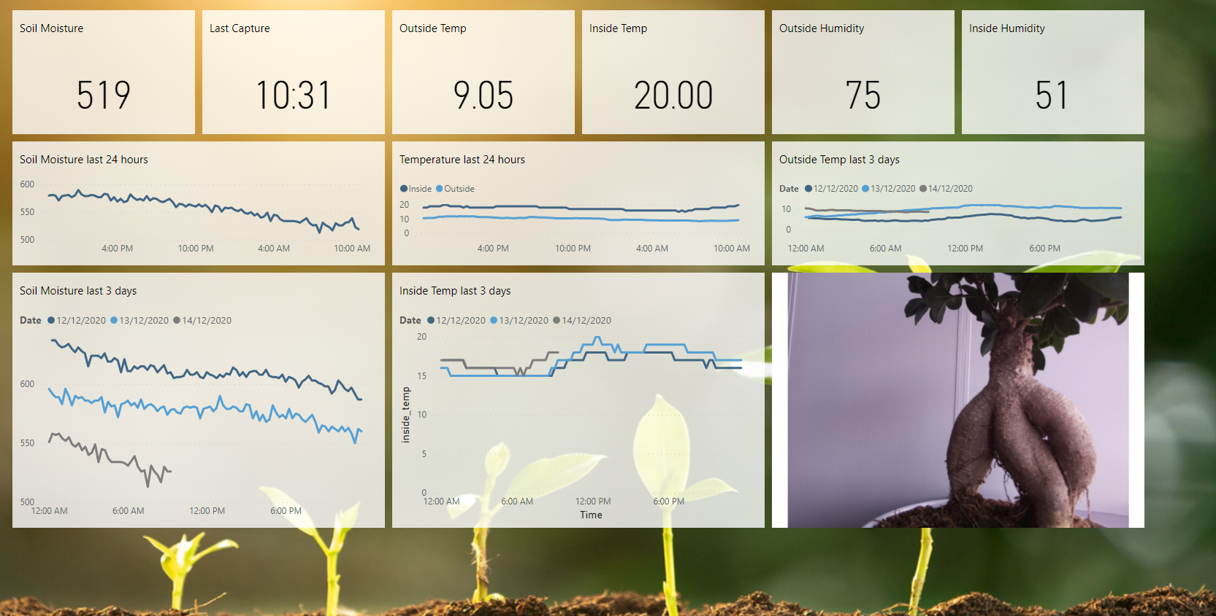
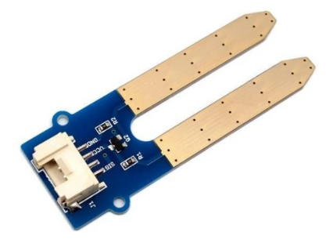


Environment Monitoring Architecture
IoT Hub
Stream Analytics
Azure Blob CSV
Power BI
Power BI Dashboard
Soil moisture
Inside Temperature
Inside Humidity
Inside Pressure
Outside Temperature
Outside Feels Like Temperature
Outside Humidity
Outside Pressure
Wind Speed
Wind Direction
Cloud Coverage
Weather Description
Weather Type
Power BI Streaming

Slide 4
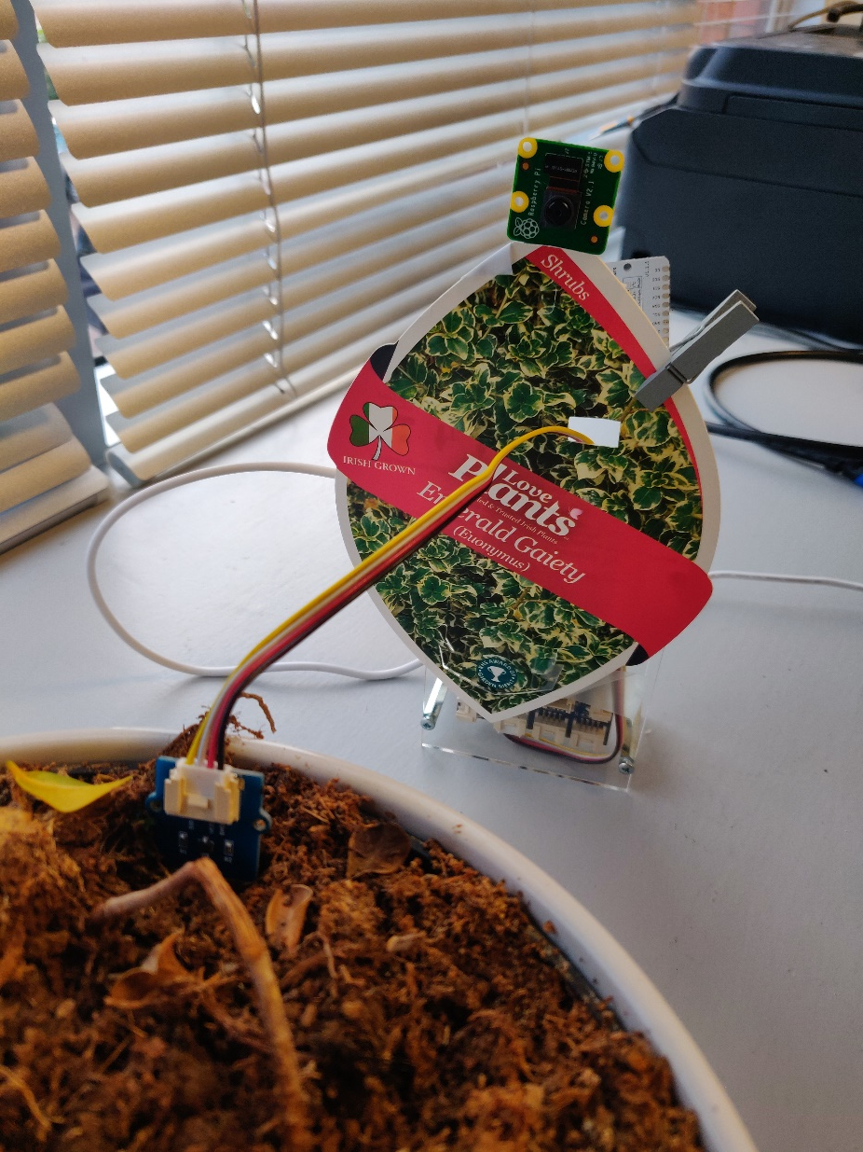
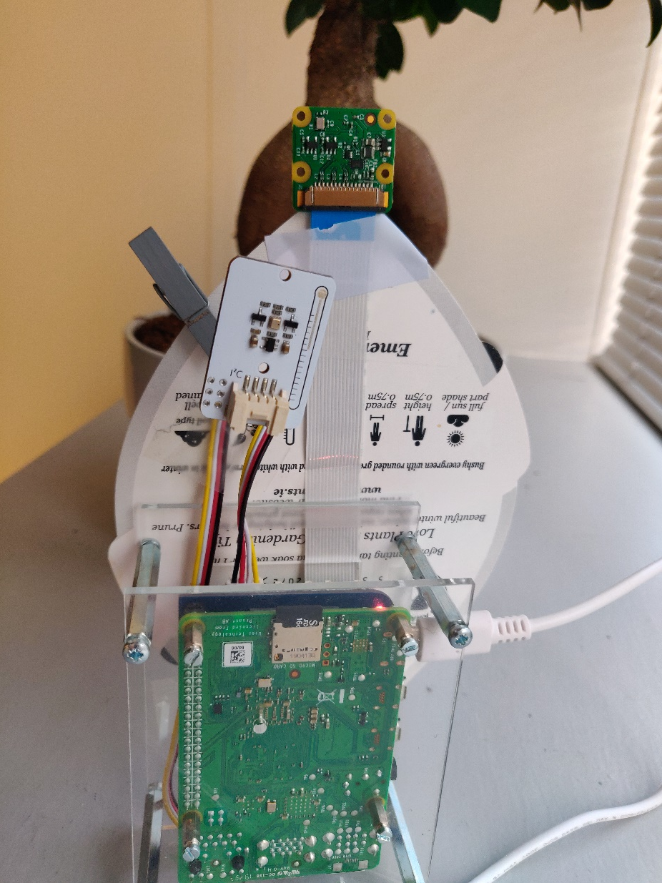
The kit
Camera
Temperature
Humidity
Pressure
Moisture

Slide 5




Done.
ben@datalineo.com
@benrebooted
linkedin.com/in/benonline
Demo content and slides here:
https://www.github.com/datalineo/sessions

